Slide 1
Impact based warnings – Lessons Learnt
Southern Africa Regional Training on Severe Weather Forecasting and Warning Service – Workshop on Public Weather Services
Pretoria, 1st -4th November 2016

Slide 2
Internal Pressures
It’s good to talk, CCA Advisors, FFC, Colleagues, Managers
Need to have an idea of level of warning and location ahead of this
Be prepared to bow to local knowledge
Advisors can be ‘keen’ to raise the level of a warning
Likewise Forecasters can have different risk appetites
IT

Slide 3
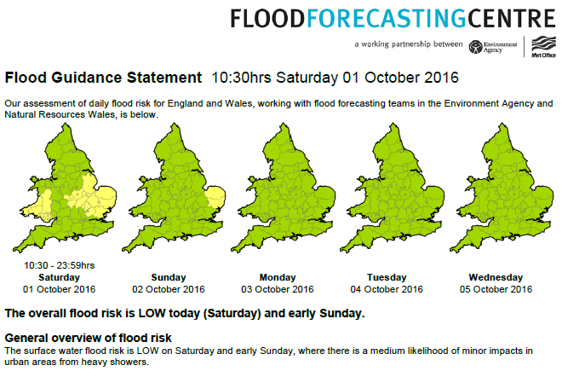

Slide 4
External Pressures
Flood Forecasting Centre (FFC), in particular, are closer to Government and can come under political pressure
Where these exist, prepare to misalign (agree to disagree), related to risk appetite of the organisation
Management in Met Office can sometimes pressure you due to external influence
Remain objective and try to deal in facts and be honest about uncertainties

Slide 5
PWS Advisors – Lessons Learnt
Many of the lessons the same as those from the Guidance Unit
Regularly spend time explaining the scheme to emergency responders – and other Met Office staff!
Short video developed to help with this – available to responders via a responder webpage.
Minor changes to the warning are not seen as helpful – for example moving boundaries by a few miles. They rarely add value and result in responders being notified even though little has changed – responders will lose interest quickly!

Slide 6
PWS Advisors – Lessons Learnt
Responders say - A no notice warning is better than no warning! Any lead time given is a bonus.
If numbers are mentioned put them into context – the first question you get if you mention rain amounts is often “is that a lot?”
Supplementary information from the Advisors is often seen as more important than the warning itself. More on this later this week!
Accept that we don’t always get it right – but evaluate each warning and use what you learn to improve the next one.
It’s good to talk! Information form emergency responders, advisors, and meteorologists is vital to a successful warning.
Make sure we are all giving the same story

Slide 7
Impact Based Warnings – upcoming changes
Warnings currently only issued up to 5 days in advance. This is being increased to 7 day.
Improvements to short notice warnings – use of Twitter for small area / short notice warnings an option.
Introduction of Thunderstorms warnings – assists with summer convection where rain may be less of a hazard than lightning hail.

Slide 8
Questions?

